Slide 1
Label-Free Supervision of Neural Networks with Physics and Domain Knowledge
2017AAAI

Slide 2
Problems
In many machine learning applications, labeled data is scarce and obtaining more labels is expensive.

Slide 3
Solutions
Unsupervised learning
Auto Encoder
Learning Compact Binary Descriptors with Unsupervised Deep Neural Networks
Learning from constrains
Label-Free Supervision of Neural Networks with Physics and Domain Knowledge

Slide 4
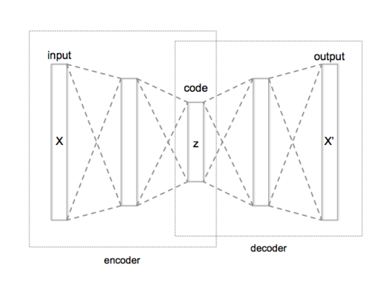
AutoEncoder
Notes:
目标是为了学习code

Slide 5
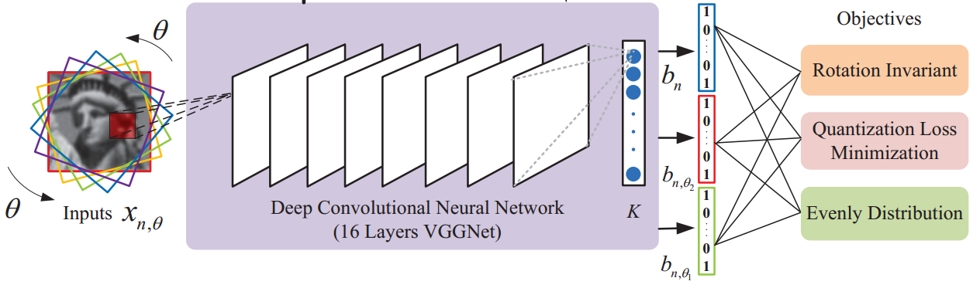
Learning Compact Binary Descriptors with Unsupervised Deep Neural Networks
Notes:
任务是学习没有标签的图片的binary descriptors，用一个向量来表示图片的特征。
然后训练的重点就是利用图片的旋转不变性。
另外两个约束是为了是训练出的向量更好。

Slide 6

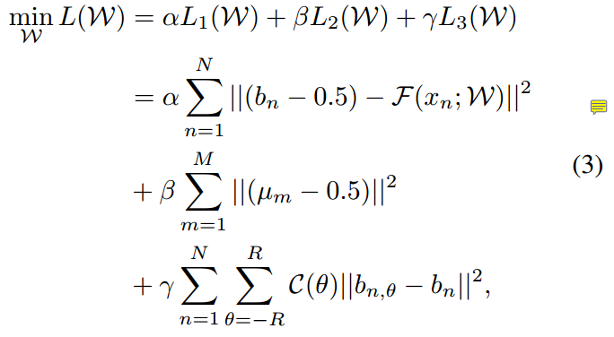
Learning Compact Binary Descriptors with Unsupervised Deep Neural Networks

Slide 7
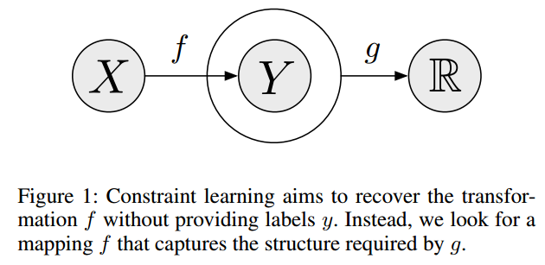
Label-Free Supervision of Neural Networks with Physics and Domain Knowledge
Notes:
监督学习就是给定输入X，和输入Y，来求f
我们基于物理或者相关领域的知识，要求输入X经过变换f的输出y应当满足一种条件，这个条件就用g来表示。

Slide 8

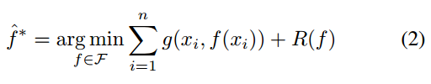
Problem Setup
Supervised learning
Learn from constrains
Notes:
总结下来，这两类问题就如ppt所示
没有标签y，R是正则化项。有时候只有g可能会产生意想不到的结果，所以加上R对f的形式做进一步的约束
这篇文章的亮点就在于对这类问题有个总结类的描述

Slide 9
Experiment1:Tracking an object in free fall
Task:
In our first experiment, we record videos of an object being thrown across the field of view, and aim to learn the object’s height in each frame.

Slide 10
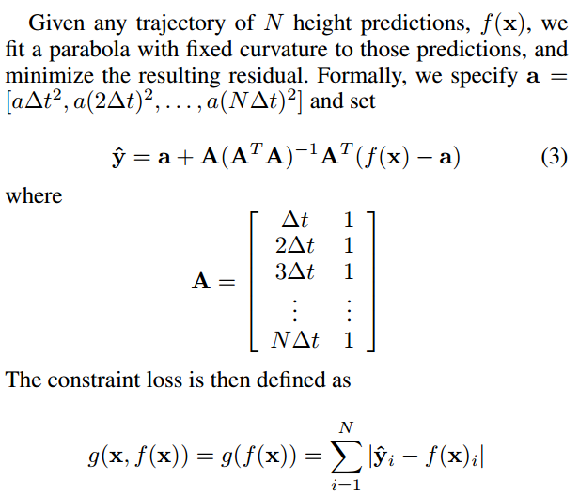
Method:
Notes:
具体化前面所说的g和R

Slide 11
Result
Our network results in a correlation of 90.1%.
supervised network : a correlation of 94.5%

Slide 12
Experiment2:Tracking the position of a walking man
Task
We will aim to detect the horizontal position of a person walking across a frame without providing direct labels.
To this end, we exploit structure that holds over time by assuming the person will be walking at a constant velocity over short periods of time.

Slide 13


Method
loss function
g(x) = jj(A(AT A)-1AT - I) ∗ f(x)jj
Problem
1
In the worst case, when λ = 0, f ≡ C, and the network can satisfy the constraint while having no dependence on the image.
Notes:
这时候就需要前面同相中的R(f)来对f进行约束

Slide 14
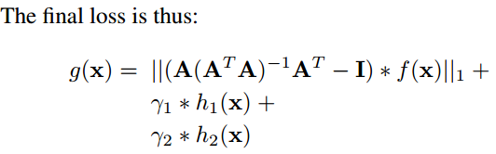


Method
Notes:
这个的实验结果比监督学习还要好。
作者认为是数据量太少，监督学习容易过拟合

Slide 15
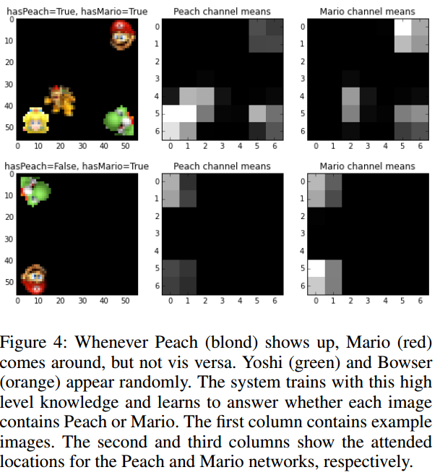
Experiment3: Detecting objects with causal relationships

Slide 16
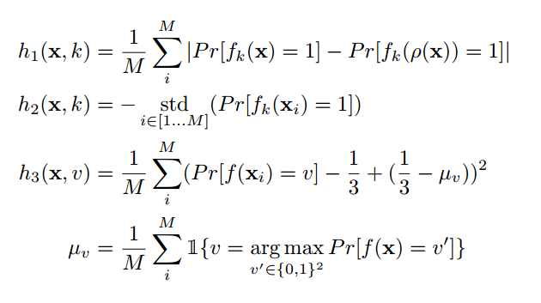
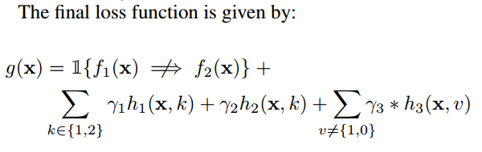
Method
Notes:
一个个公式介绍
Our aim is to create a pair of neural networks f1, f2 for identifying Peach and Mario, respectively.
To avoid such trivial solutions, we add three loss terms: h1, h2, and h3. h1 forces rotational independence of the output by applying a random horizontal and vertical reflection ρ, to images. This encourages the network to focus on existence of objects, rather than location. h2 and h3 allows us to avoid trivial solutions by encouraging high standard deviation and high entropy outputs, respectively. Given a batch of M = 16 images which we denote x, we define

Slide 17
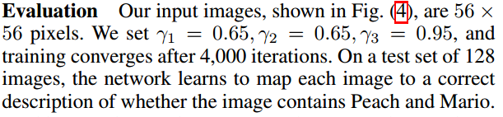
Result

